Slide 1



Bridge Processing
WMS Interface
IGATE is now a part of Capgemini

Slide 2
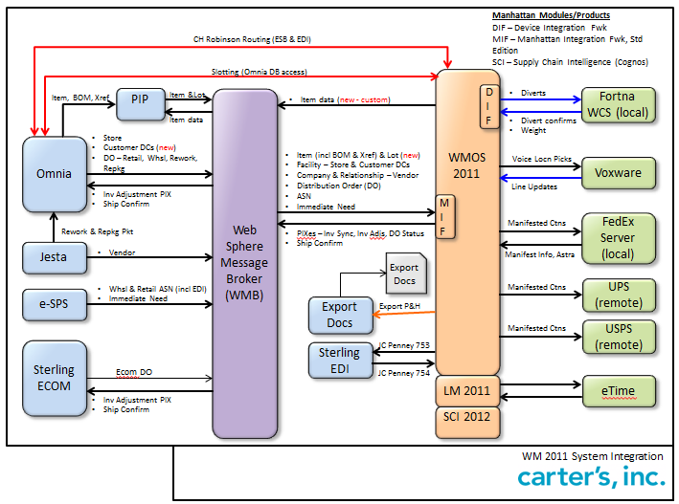
Braselton Interface Flow Diagram

Slide 3
Agenda
Overview
Input Interfaces
Interface Initiation
Output Interfaces
Error Processing

Slide 4
Overview
Bridge
- is an entity which connects two or more isolated units.
- is the mechanism of transferring information between Host and WM Tables

Slide 5
Input Interface Process
WMS Tables
Host System
XML/
Flat Files
INPT_<Tables>
EIS
Bridges
EIS - Enterprise Integration Services

Slide 6
Data into Input tables
Host System
XML/ Flat file
INPUT_<Tables>
EIS
Host System
Directly

Slide 7
Input Interfaces Contd…
XML Transactions:
Host systems can create MANH XML messages for each INPT table via EIS with Datalink.
Flat Files:
Host systems can download flat files that will be used to update the WM INPT tables via EIS with Datalink
Host systems can also bridge records directly into the INPT bridge tables
Once data in the INPT tables, WM uses transfer (bridge) programs that move and convert all rows from the input tables into WM data table

Slide 8
Interface Initiation Contd…
Command line initiation
All INPT interface processes can be initiated by running a bridge program (.EXE from a command line).
Following techniques are used to initiate the bridge program:
Chronological (Cron job): A Cron job refers to a system management setting that is configured to execute programs at regular time intervals (i.e. once an hour, once a day, once a week, etc.). The use of a Cron job allows the bridge process to be executed at regular intervals with no user interaction
Host initiated

Slide 9
Command line initiation
PkBridgeC –u <user_id> –b item
INPT_ITEM_MASTER
INPT_ITEM_WHSE_MASTER
INPT_ITEM_PACK_QTY
ITEM_MASTER
ITEM_WHSE_MASTER
ITEM_PACK_QTY
ITEM
INPT_ASN_DTL
INPT_ASN_HDR
ASN_HDR
ASN_DTL
ASN
PkASNBridge –u <user id>

Slide 10
Interface Initiation
Command line initiation
SOA INPT interface process

Slide 11
Interface Initiation Contd…
SOA : Service oriented architecture is essentially a collection of services.
SOA INPT interface process: Interfaces can be initiated as SOA services (.DLL from an interceptor) directly by EIS.
These .DLL services can be enabled during the EIS/Datalink installation by configuring the endpoint that invokes the interceptor to automatically run the bridge program

Slide 12
Input Bridges
Appt Sched Bridge
ASN Bridge
Item Master Bridge
PO Bridge
Vendor Bridge
Batch Master Bridge
Case Conversion
Pickticket Bridge
Store Master Bridge
Store Distro Bridge

Slide 13
Input Bridges
INPT_<Tables>
WMS Tables
Items
Cases
Pick tickets
Stores
Distro

Slide 14
Output Interface
WMS
XML/
Flat Files
HOST
EIS
Bridges

Slide 15
Output Bridges
WMS
XML / Flat files
Carton
Pick Tickets

Slide 16
Output Bridges
Invoice Bridge
PIX Bridge

Slide 17
Error Processing
INPT_<TABLES>
PROC_STAT_CODE
error_seq_nbr
MSG_LOG
(ref_value_1)
WMS_<TABLES>
Bridges

Slide 18
Error Processing Contd…
When an input error occurs, the system will flag the record in the input table that caused the generation of the error by updating the Process Status Code (PROC_STAT_CODE) to ‘10’, Error.
Each error message is recorded in the Message Log (MSG_LOG) with the actual error message generated.
Both the INPT record (ERROR_SEQ_NBR ) and MSG_LOG (REF_VALUE_1) record are updated with the same WM generated error sequence number.

Slide 19
Error Correction
Error has to be corrected via the Input Bridge Error Inq/Maint UI, the corresponding Process Status Code will be reset to ’00 - Not Processed’, allowing WM to attempt to bridge the file across again.

Slide 20
Thank You

Slide 21
Waving Process
Waving Process involves the following tasks:
Wave Starter: The order from the host is sent to the WMS.
Order Sequencing: Selecting the orders from the order pool.
Pick Select Sequencing: It determines the sequence in which orders
to be picked.
Allocation: Allocates the inventory to an order.
Cubing: It determines which SKU’s should be packed in the carton’s
and how these carton’s should be packed. (Optimal content to be packed in a carton)

Slide 22
Waving Process
Routing: It determines the route through which the items to be shipped
to the end user.
Zone Picking: It determines from which location(Active or Case pick or
Reserve ) inventory should be picked.
Pack Wave: It involves packing activities for the inventory.
Order Consolidation: It will consolidate the two similar orders into one order.

